Slide 1
Digital Portfolio
STUDENT NAME: U. HEMALAKSHMI
REGISTER NO AND NMID: 641800A0B16F1AD968A4D1537
DEPARTMENT: BSC.COMPUTER SCIENCE
COLLEGE / UNIVERSITY: SSKV COLLEGE OF ARTS AND SCIENCE FOR WOMEN /MADRAS UNIVERSITY

Slide 2
PROJECT TITLE
INTERACTIVE DIGITAL PORTFOLIO USING FRONTEND WEB DEVELOPMENT

Slide 3


AGENDA
Problem Statement
Project Overview
End Users
Tools and Technologies
Portfolio design and Layout
Features and Functionality
Results and Screenshots
Conclusion
Github Link
3/21/2024 Annual Review

Slide 4

PROBLEM STATEMENT
•Traditional resumes and static portfolios fail to showcase real design thinking, process, and impact. •Recruiters and clients often struggle to evaluate a designer’s end-to-end problem-solving ability from fragmented case studies. •Designers need a single platform that highlights skills, case studies, testimonials, and personality while being accessible, responsive, and engaging. •Without a thoughtfully designed portfolio, opportunities to build trust and credibility with potential collaborators are lost.

Slide 5

PROJECT OVERVIEW
Project Title: Hemalakshmi — UI/UX Designer Portfolio Website Objective: Create a responsive, modern, and accessible portfolio platform that showcases case studies, skills, process, and testimonials. Key Features: •Interactive case studies with prototypes and design documentation •About & process sections to highlight design thinking •Skills grid & testimonials for credibility •Contact form with email integration •Light/Dark theme toggle with persistence •Responsive design optimized for web & mobile Target Audience: Recruiters, product teams, and potential clients seeking a skilled UI/UX designer.
Outcome: A professional digital presence that communicates expertise, builds trust, and supports career opportunities.

Slide 6

WHO ARE THE END USERS?
END USERS
• Hiring Managers & Recruiters
• Potential Clients / Founders
• Design Peers & Collaborators
• General Audience / Learners

Slide 7
•Hiring Managers & Recruiters Evaluate design skills, case studies, and experience. Use the portfolio to shortlist for roles. •Potential Clients / Founders Assess credibility before offering freelance or contract work. Look for design thinking, process, and results. •Design Peers & Collaborators Explore portfolio for networking and collaboration. Gain insights into design systems, workflows, and style. •General Audience / Learners Students or aspiring designers seeking inspiration. Community members exploring UI/UX approaches.

Slide 8

TOOLS AND TECHNIQUES
TOOLS
Design Tools: •Figma – Wireframing, UI design, prototyping •Illustrator / Photoshop – Visual assets, icons, branding •Notion / Miro – Research synthesis, journey mapping, brainstorming
Development Tools: •HTML5, CSS3, JavaScript (ES6) – Core web technologies •Responsive Grid & Flexbox – Adaptive layouts for devices •LocalStorage API – Theme persistence (light/dark mode) •IntersectionObserver API – Scroll-triggered reveal animations

Slide 9
Techniques
•User-Centered Design (UCD) – Iterative, research-led approach •Accessibility (WCAG 2.1) – Semantic HTML, ARIA labels, focus states •Usability Testing – Validating forms, navigation, and responsiveness •Design Systems & Tokens – Consistency in typography, colors, spacing •Performance Optimization – Preloading fonts, minimizing DOM complexity

Slide 10
POTFOLIO DESIGN AND LAYOUT
Objective Build a professional UI/UX portfolio website to showcase projects, skills, and experience. Design Approach •Modern, clean layout with grid systems. •Strong focus on typography (Inter & Playfair Display) for readability. •Dark & Light themes with toggle support. •Responsive design for seamless viewing across devices.
10

Slide 11
Layout Highlights •Hero Section – Introduction, role badge, and call-to-action buttons. •Work Section – Case studies & projects with filterable categories. •About Section – Stats & background for credibility. •Process Section – Step-by-step design workflow. •Testimonials & Skills – Social proof + toolset. •Contact Section – Interactive form integrated with email.

Slide 12
Interactive Elements •Scroll reveal animations for engaging user experience. •Filter chips to sort projects dynamically. •Accessible navigation with skip-to-content links & ARIA labels. Outcome A visually appealing and user-friendly portfolio that communicates design thinking, showcases projects effectively, and supports collaboration opportunities.

Slide 13
FEATURES AND FUNCTIONALITY
•Modern Responsive Design Adaptive layout optimized for desktop, tablet, and mobile devices. •Theme Switching Dark & Light mode toggle with preference saved for future visits. •Smooth User Experience Scroll reveal animations for engaging interactions. Sticky navigation for quick section access. •Interactive Work Showcase Filterable project grid (Apps, Web, Dashboards, Branding). Case study pages, live prototypes, and design file links.

Slide 14
Structured Information Sections •Hero – Introduction & call-to-actions. •About – Experience, stats, and achievements. •Process – Step-by-step design methodology. •Testimonials & Skills – Credibility and expertise overview. Contact & Integration •Interactive contact form with email integration. •Social links: Dribbble, Behance, LinkedIn, Email. Accessibility Features •Skip-to-content link, ARIA labels, semantic HTML. •Keyboard and screen-reader friendly navigation.

Slide 15
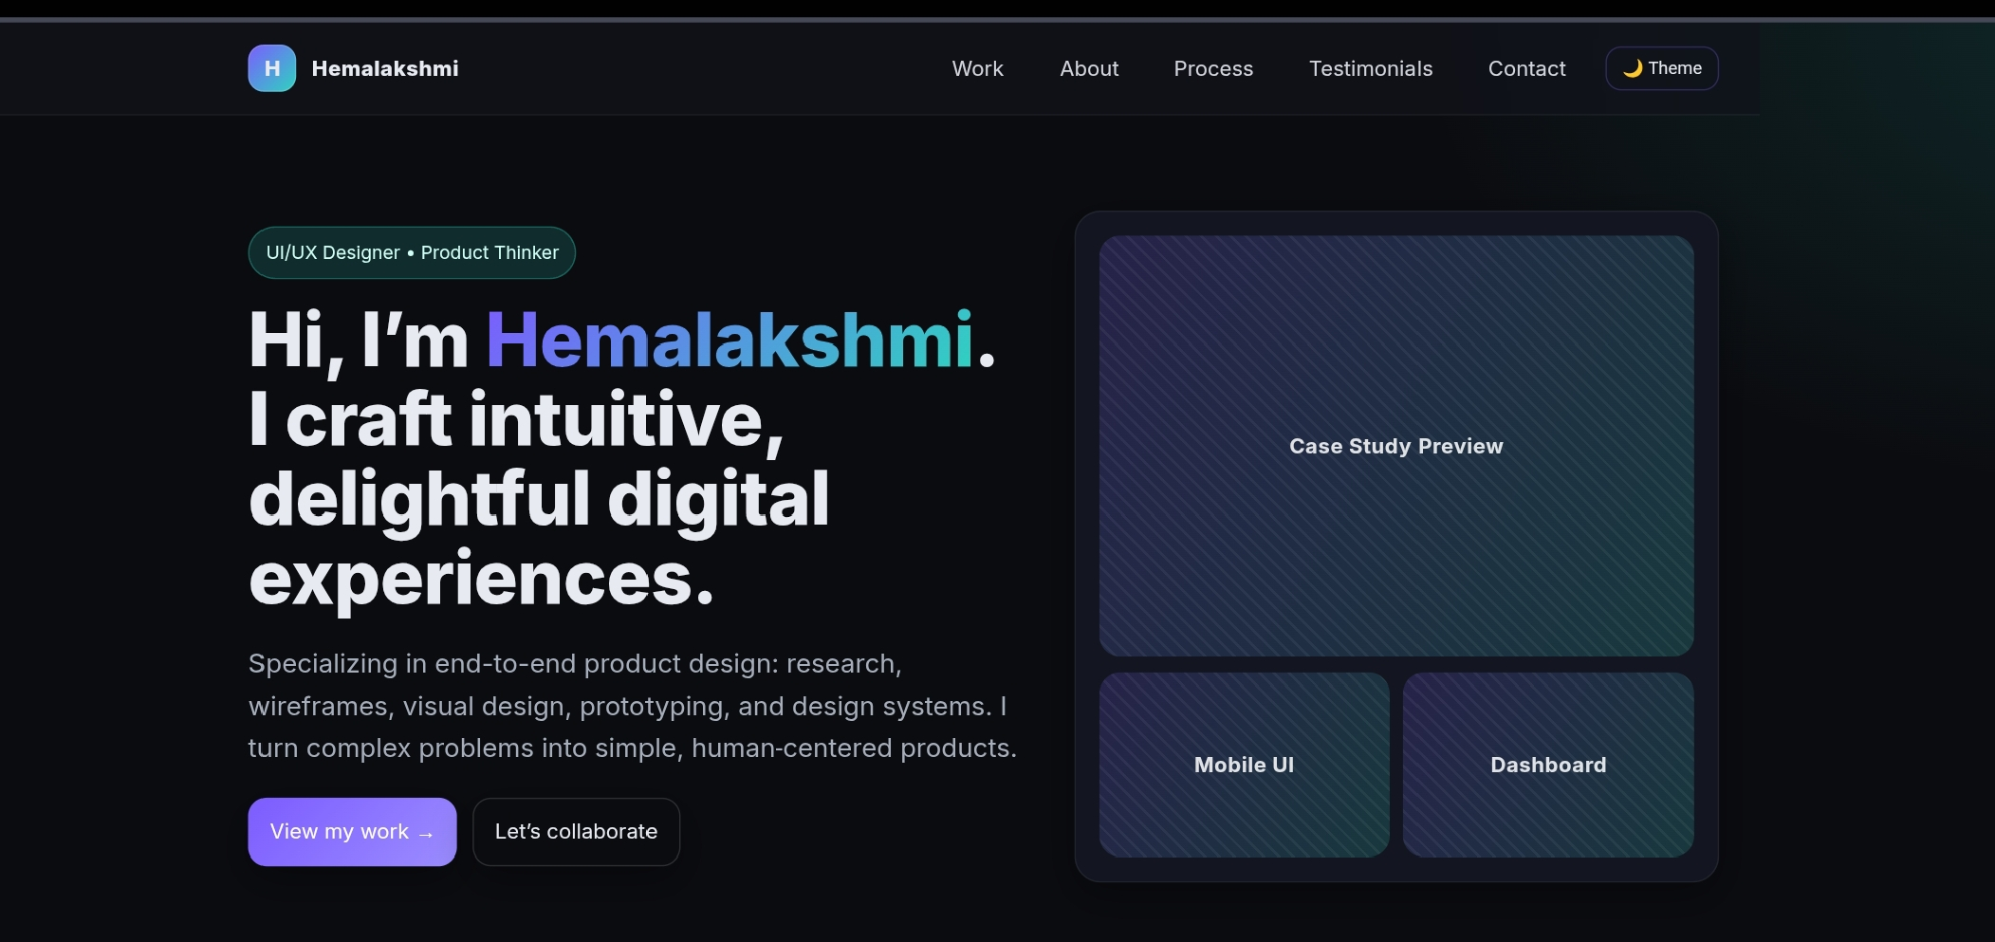

RESULTS AND SCREENSHOTS
3/21/2024 Annual Review
15

Slide 16
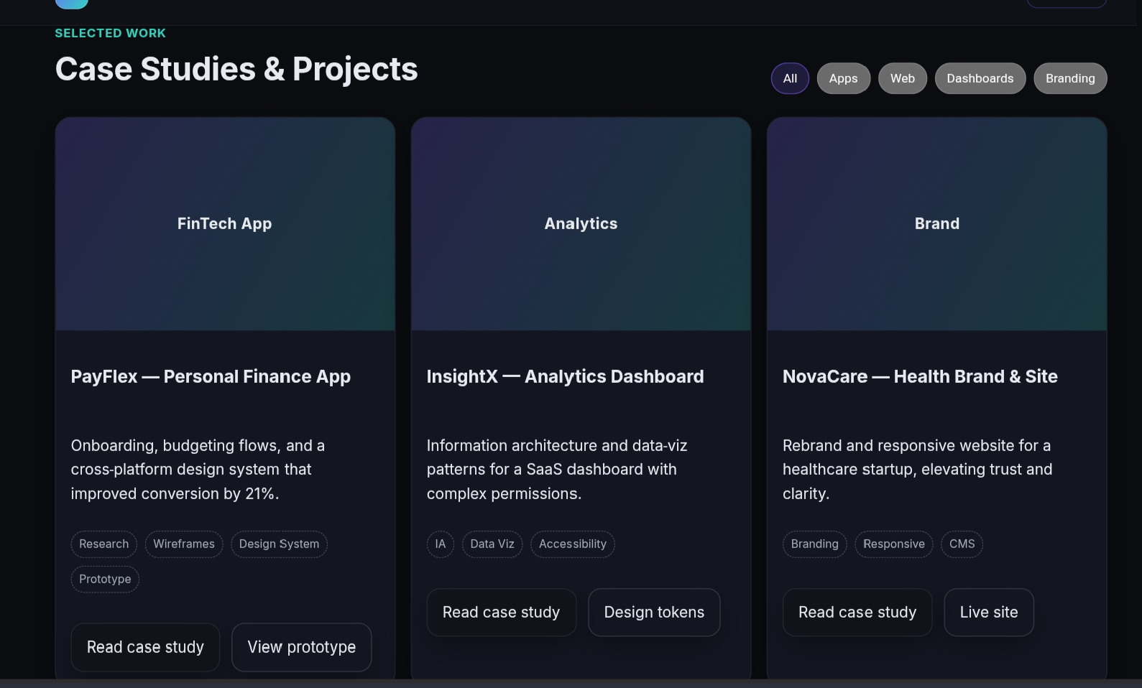

Slide 17
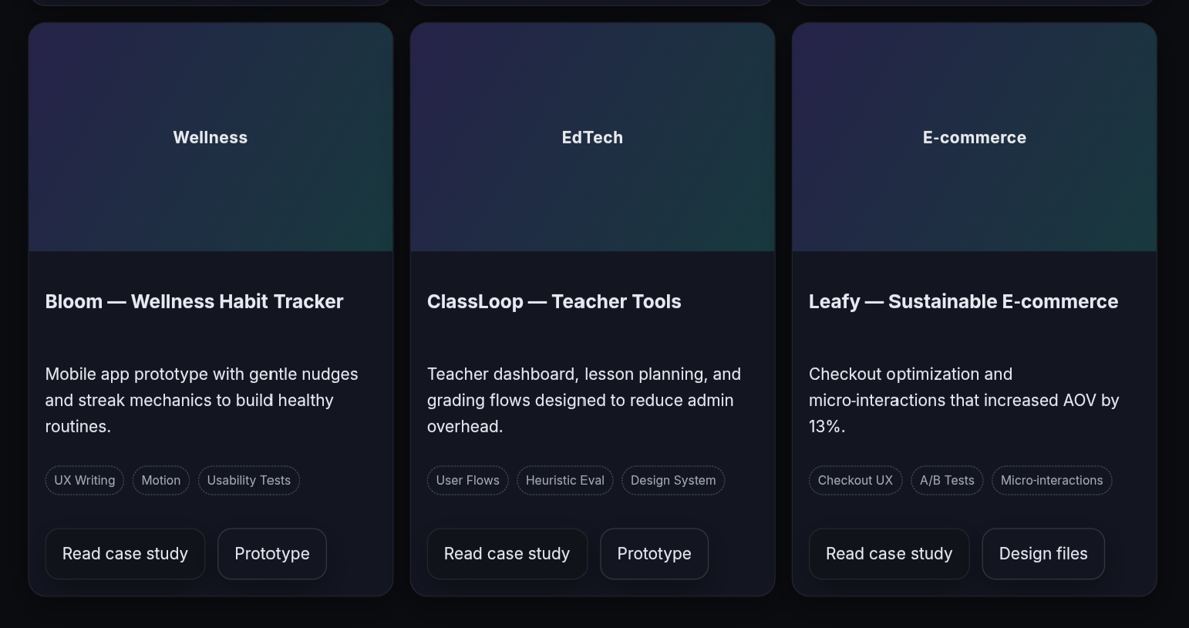

Slide 18
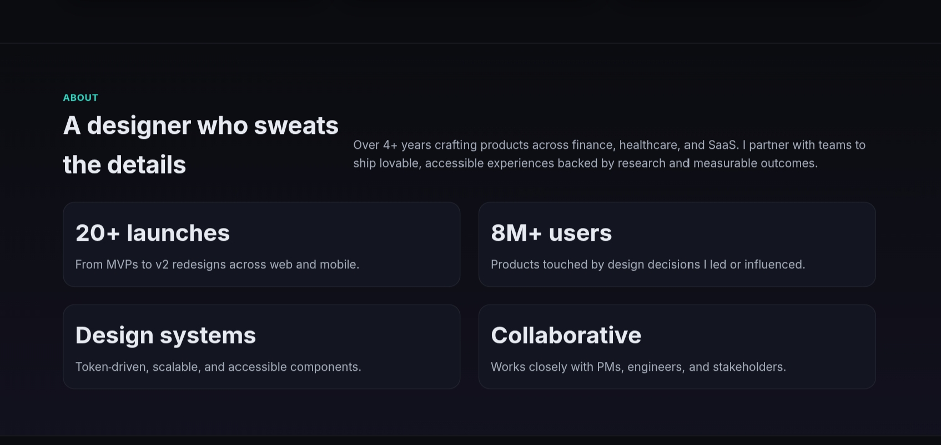

Slide 19
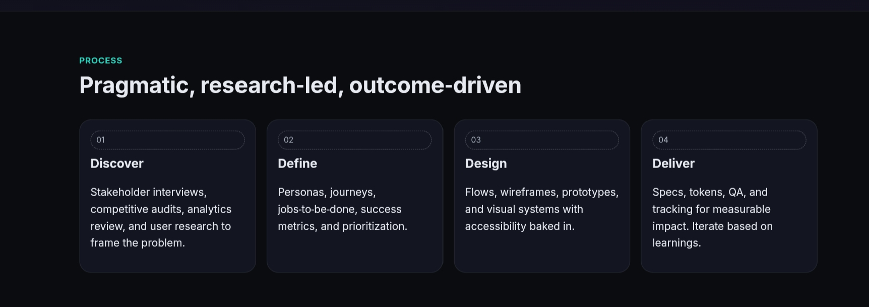

Slide 20
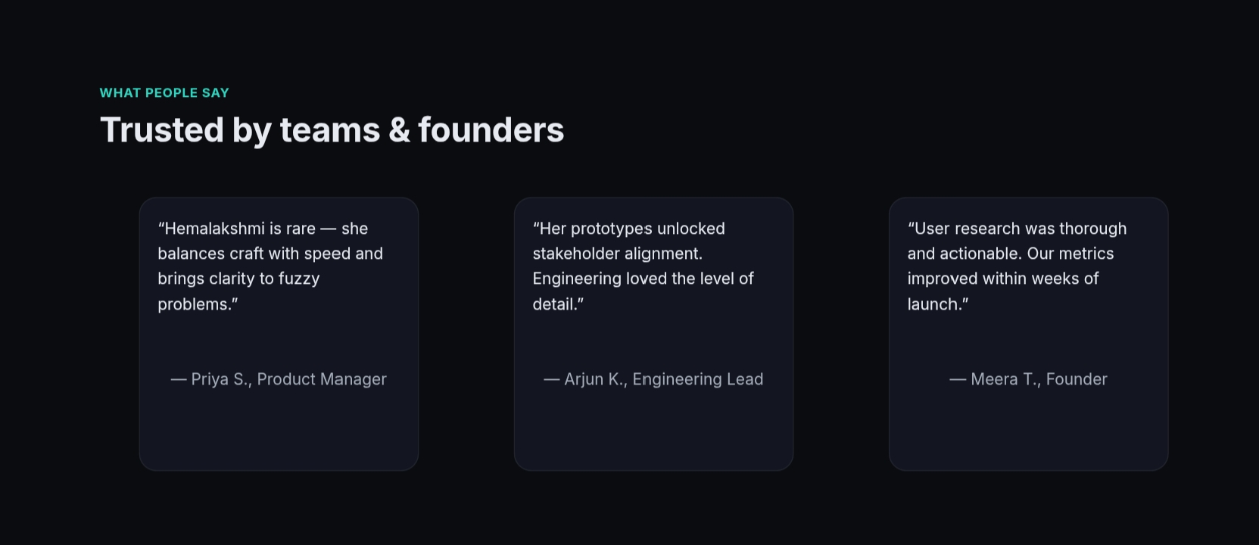

Slide 21
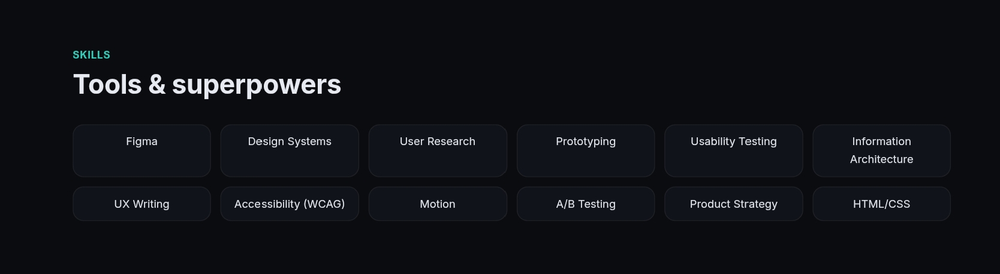

Slide 22
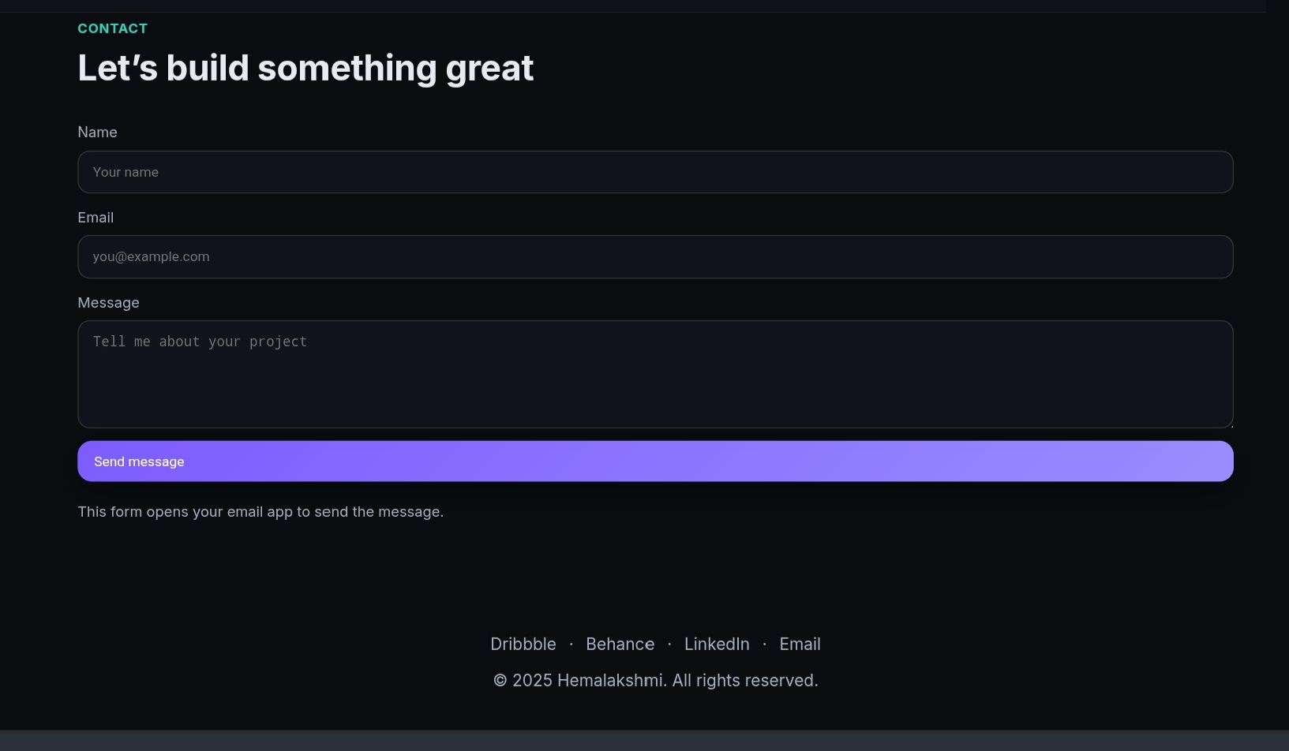

Slide 23
CONCLUSION
“This portfolio project showcases my approach to crafting intuitive, human-centered digital experiences. With a focus on research, design systems, and usability, it reflects my commitment to turning complex problems into simple, impactful solutions.”
23

